Slide 1
Master’s thesis defence
Multi-Focus Image Fusion
via Deep Multimodal
Convolutional Sparse Coding
PETIO TODOROV
MASTER IN APPLIED COMPUTER SCIENCE
SEPTEMBER 3, 2021

Slide 2
INTRODUCTION
Introduction

Slide 3
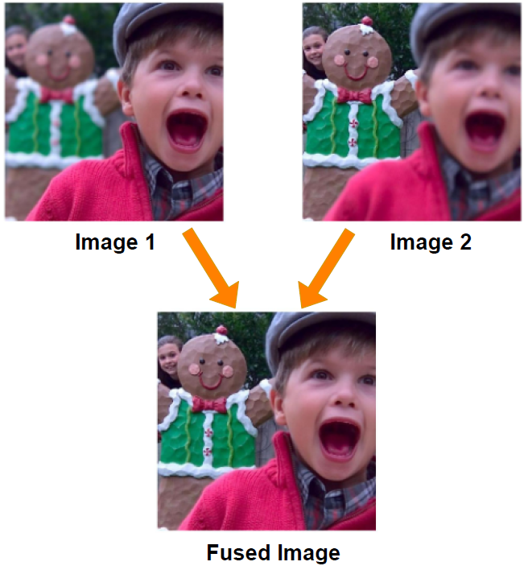
INTRODUCTION
Presentation Content
Problem Overview
Background on our Solution
Sparse Coding and Convolutional Sparse Coding
Attention Mechanism
Network Design and Configuration
3 Networks
Experiments and Results
Training Dataset Preparation
Visual and Numerical Results
Conclusion

Slide 4
INTRODUCTION
Problem Statement-
Multi-Focus Image Fusion (MFIF)
2 Source Images = Input
a near-focused image
a far-focused image
Fused Image = Output
all-in focus image

Slide 5
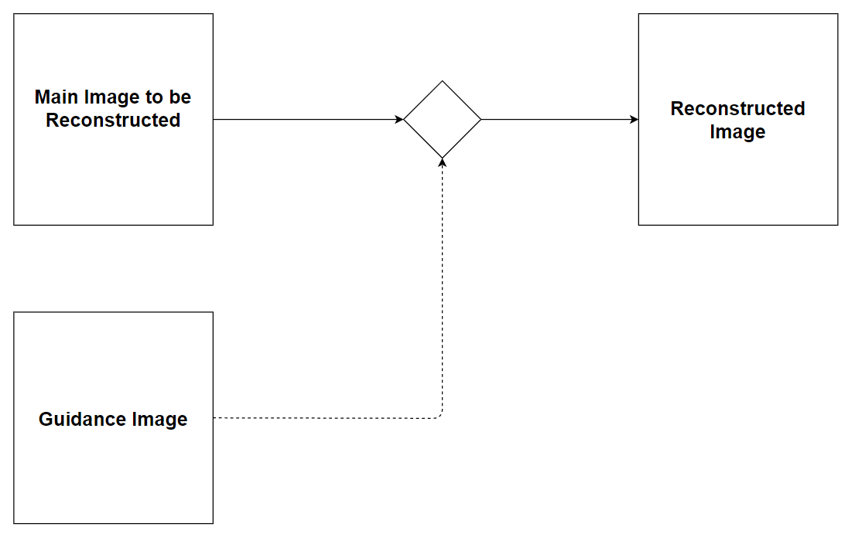
INTRODUCTION
Proposed Solution
Image Reconstruction via a Guidance Image

Slide 6
Background
Background Information

Slide 7
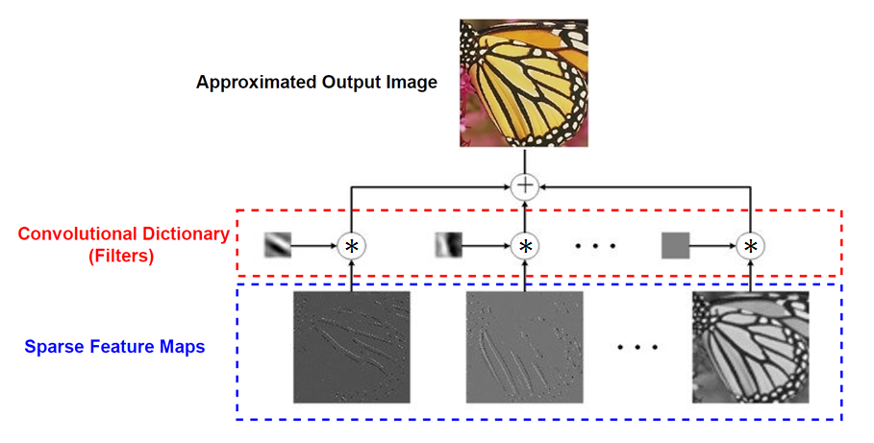
Background
Convolutional Sparse Coding (CSC)

Slide 8
methods
Methods

Slide 9
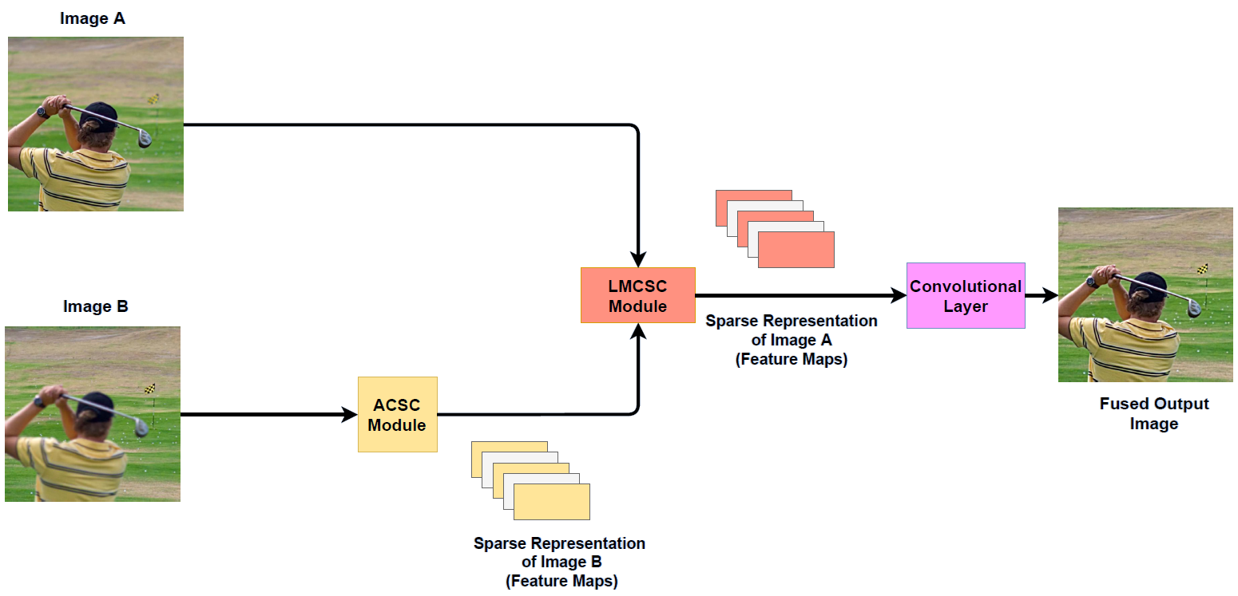
methods
Network 1 (Base Network)

Slide 10
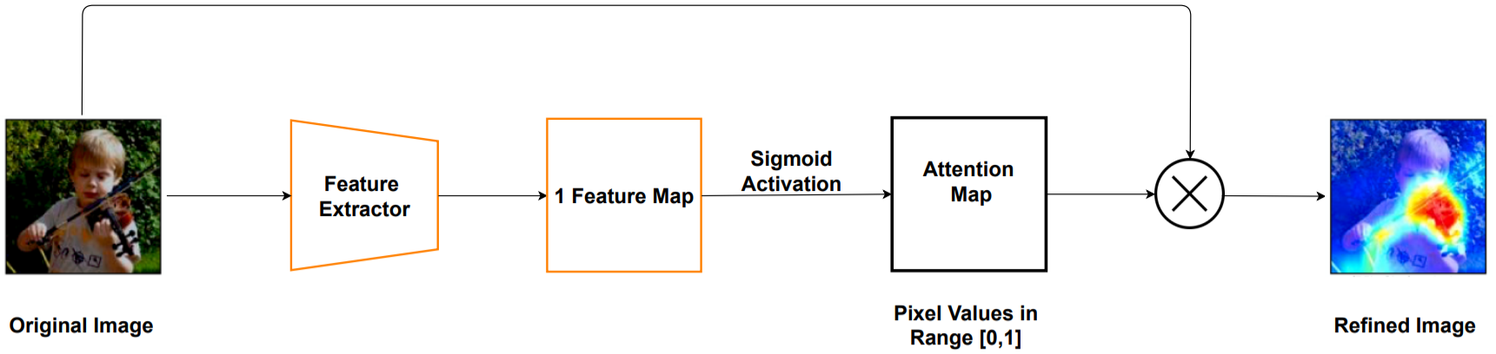
Background
Attention Mechanism

Slide 11
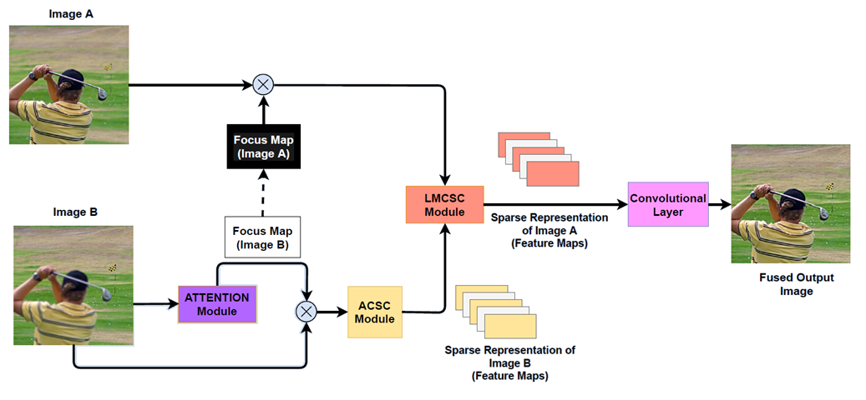
methods
Network 2 (Base + Attention)

Slide 12
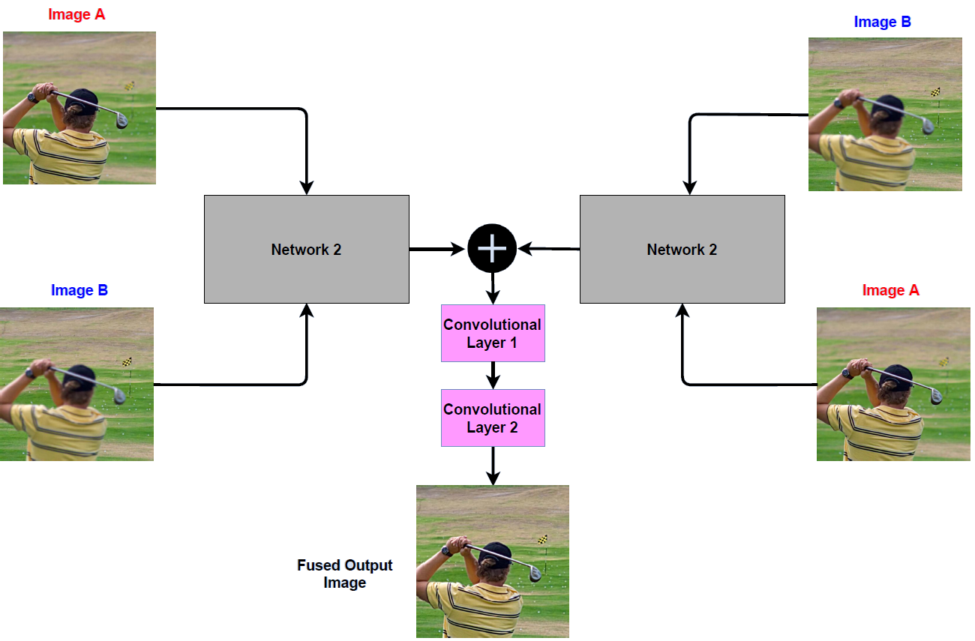
methods
Network 3 (Dual Network)

Slide 13
Background
Experiments & Results

Slide 14
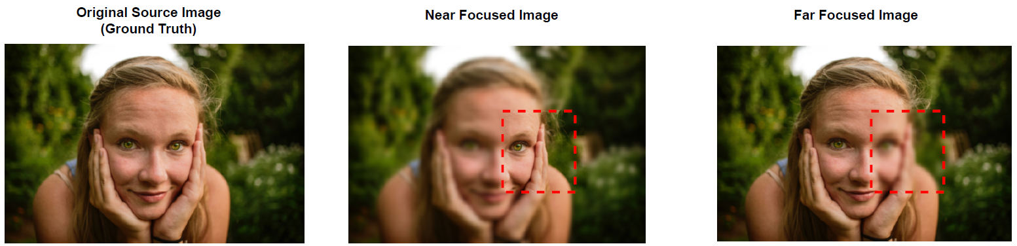
Experiments & results
Training Dataset Preparation

Slide 15
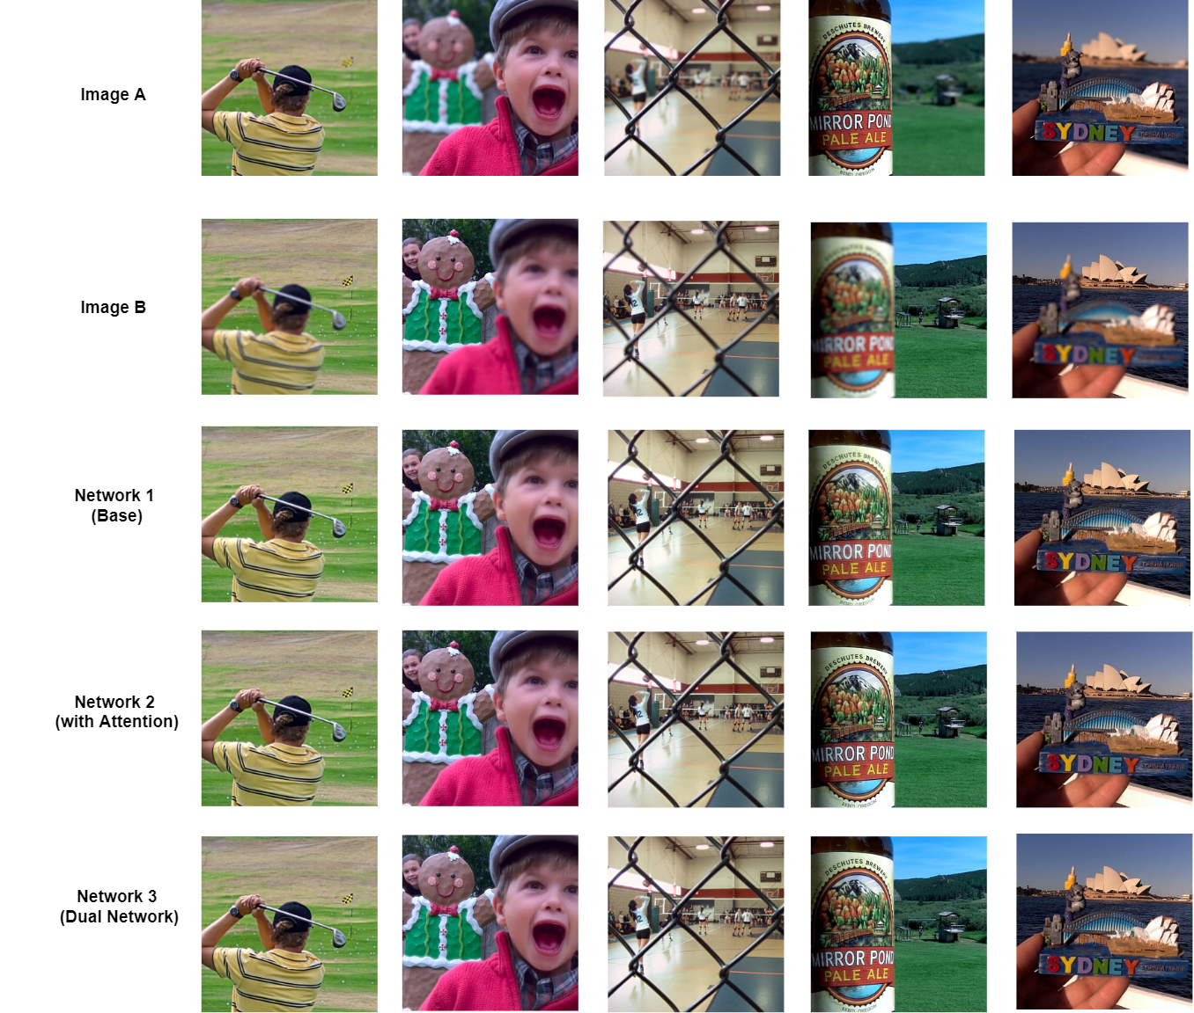
Experiments & results
Visual Results
Testing performed on 20 Lytro Dataset Images

Slide 16
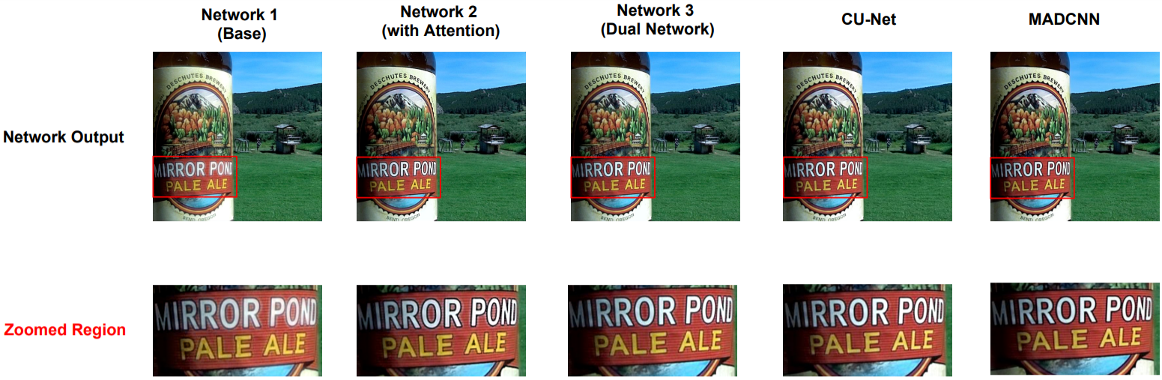
Experiments & results
Visual Results

Slide 17
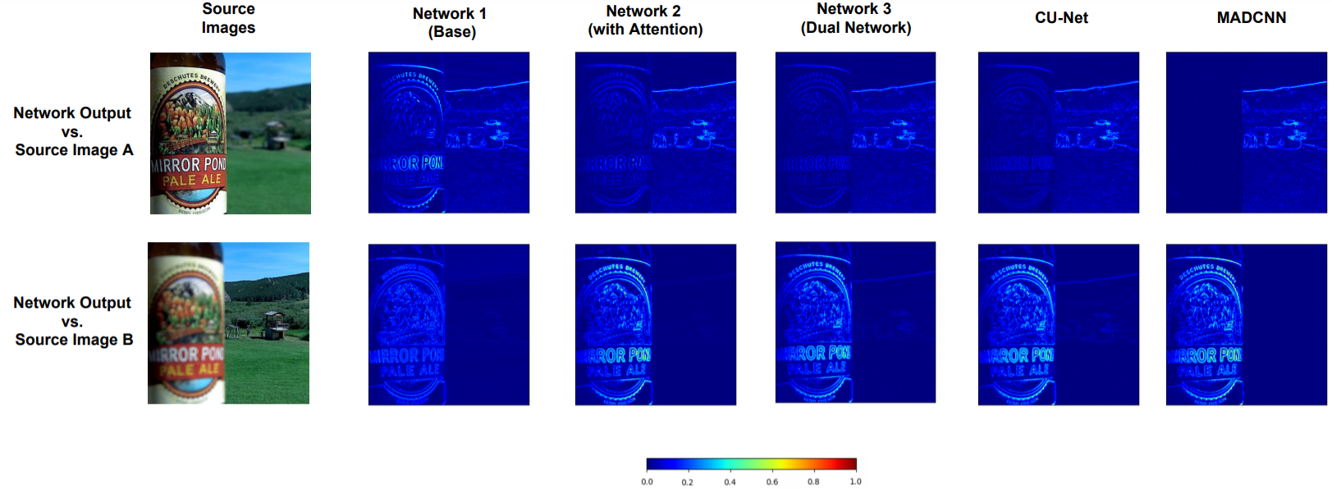
Experiments & results
Error Maps

Slide 18
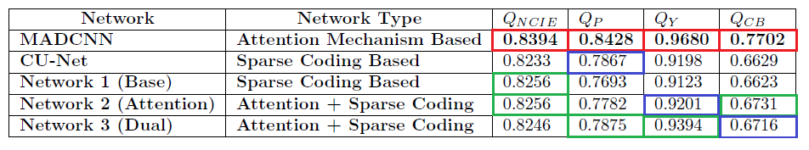
Experiments & results
Numerical Results
Networks 2 and 3 outperform Network 1
Network 2 beats CU-Net in 3 out of 4 metrics
Network 3 beats CU-Net in all 4 metrics
MADCNN has best numerical performance

Slide 19
Conclusion
Conclusion

Slide 20
Conclusion
Conclusion
Multi-Focus Image Fusion (MFIF)
Created 3 Networks
Network 1- Base Network
Network 2- Base + Attention Network
Network 3- Dual Network
All successfully create Multi-Focus Images
Compared well to state-of-art papers

Slide 21
Acknowledgments
Acknowledgments

Slide 22
DANK u
Notes:
Thanks for listening!

Slide 23
References
References
Slide 2-3- X. Zhang, Multi-focus image fusion: A benchmark, 2020. arXiv: 2005.01116 [cs.CV].
Slide 7- L. Li, S. Zhang, L. Jiao, F. Liu, S. Yang, and X. Tang, \Semi-coupled convolutional sparse learning for image super-resolution," Remote Sensing, vol. 11, no. 21, 2019, issn: 2072-4292. [Online]. Available: https://www.mdpi.com/2072-4292/11/21/2593.
Slide 10- https://www.arxiv-vanity.com/papers/1812.10025/
Slide 16-17-18- CU-Net- X. Deng and P. L. Dragotti, \Deep convolutional neural network for multi-modal image restoration and fusion," CoRR, vol. abs/1910.04066, 2019. arXiv: 1910.04066. [Online]. Available: http://arxiv.org/abs/1910.04066.
Slide 16-17-18- MADCNN- R. Lai, Y. Li, J. Guan, and A. Xiong, \Multi-scale visual attention deep convolutional neural network for multi-focus image fusion," IEEE Access, vol. 7, pp. 114 385{114 399, 2019. doi: 10.1109/ACCESS.2019.2935006.

